Slide 1
Blockchain
Lesson 2
Under the Hood

Slide 3
Prompt Option #1
Blockchain Lesson 2 - Warm Up
Two friends, Kim and Isaac, want to send secret messages to each other but their parents read all of their text messages. How do you think they can communicate with each other even if someone reads all of their messages?

Slide 4
Prompt Option #2
Blockchain Lesson 2 - Warm Up
Imagine two people, Kim and Isaac, had to make a purchase without ever meeting: Kim wants to pay Isaac $300 for the latest gaming system. What potential issues could arise as they try to complete this transaction with each other?

Slide 6
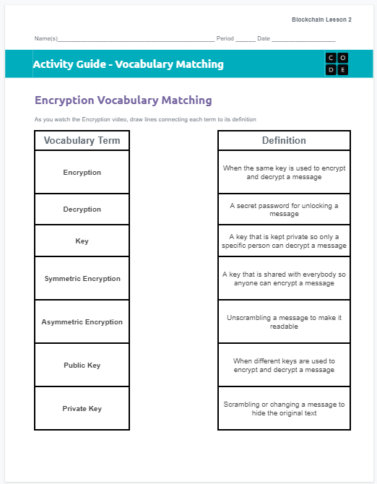
Blockchain Lesson 2 - Activity
Distribute
You should have:
Vocabulary Matching - Activity Guide
Pen/Pencil

Slide 7
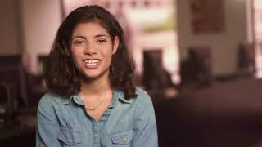
Blockchain Lesson 2 - Activity
Public-Key Encryption

Slide 8
Key Vocabulary
Blockchain Lesson 2 - Activity
Encryption: Scrambling or changing of a message to hide the original text
Decryption: Unscrambling a message to make it readable
Key: A secret password for unlocking a message
Symmetric Encryption: When the same key is used to encrypt and decrypt a message

Slide 9
Key Vocabulary
Blockchain Lesson 2 - Activity
Asymmetric Encryption: When different keys are used to encrypt and decrypt a message
Public Key: A key that is shared with everybody so anyone can encrypt a message
Private Key: A key that is kept private so only a specific person can decrypt a message

Slide 10
Blockchain Lesson 2 - Activity
Private (Only they can see)
Original Message It’s me Kim! Meet me in an hour
Decrypted Message It’s me Kim! Meet me in an hour
Isaac’s
Private Key
Isaac’s Public Key
Public (Anyone can see)
Encrypted Message kairdklsoc02lask23

Slide 11
Key Vocabulary
Blockchain Lesson 2 - Activity
Message Hash: a unique representation of an original message that has been transformed so it is unrecognizable.
Original Message
Hey it’s Kim!
Message Hash
8ac819deffa821
Original Message
What time is the movie?
Message Hash
edde6271decc82
Original Message
meet me in an hour
Message Hash
3485ca368abb61
Original Message
Meet me in an hour
Message Hash
8ac819deffa821

Slide 12
Hash Example
Blockchain Lesson 2 - Activity
Hashes should be easy to create, but hard to reverse!
Convert each letter into its position in the alphabet
Put all of the numbers together, creating a long string of numbers
A dog barks
🤔❓
Nogb khaa s
1 4 15 7 2 1 18 11 19
14 15 7 2 11 8 1 1 19
✅
1415721181119
141572 11811 19

Slide 13
Blockchain Lesson 2 - Activity
Private (Only they can see)
Original Message
Meet me in an hour
Message Hash
8ac819deffa821
Kim’s Private Key
Public (Anyone can see)
Signature
931ab31aecc291ae
Original Message
Meet me in an hour

Slide 14
Blockchain Lesson 2 - Activity
Private (Only they can see)
Original Message
Meet me in an hour
Public (Anyone can see)
Kim’s Public Key
Signature
931ab31aecc291ae
Decrypted Signature
8ac819deffa821
Original Message
Meet me in an hour
Message Hash
8ac819deffa821

Slide 15
Blockchain Lesson 2 - Activity
💻
Code Studio
Log into Code Studio
Open Level 1 Widget - Verifying Signatures

Slide 16
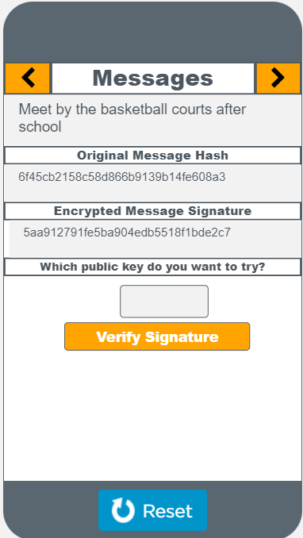
Blockchain Lesson 2 - Activity
Code Studio
Use the widget on the left to view the messages. You can use the orange arrows at the top to scroll between messages. There are four messages in total

Slide 17
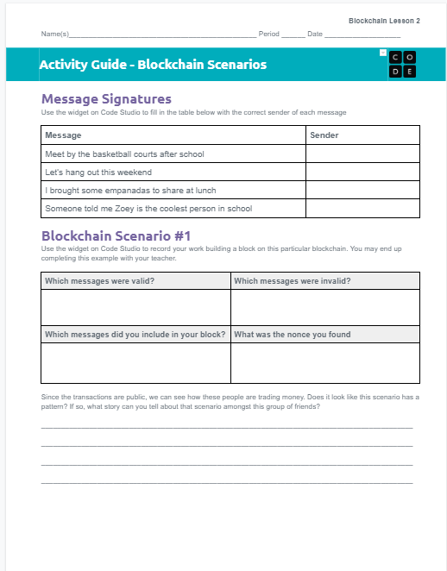
Blockchain Lesson 2 - Activity
Distribute
You should have:
Blockchain Scenarios - Activity Guide
Pen/Pencil

Slide 18
Blockchain Lesson 2 - Activity
Do This
Follow the directions on the widget to verify the signatures of each message
Record your answers on the activity guide

Slide 19
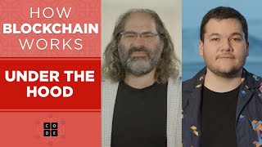
Blockchain Lesson 2 - Activity
Video

Slide 20
Key Vocabulary
Blockchain Lesson 2 - Activity
Ledger - A record of all transactions in a group
Consensus - A mechanism requiring enough people to agree which transactions are valid
Proof of Work - Verifying information with a lot of computing effort

Slide 21
Blockchain Lesson 2 - Activity
💻
Code Studio
Log into Code Studio
Open Level 2 Widget - Blockchain Scenario 1

Slide 22
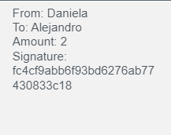
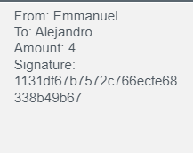
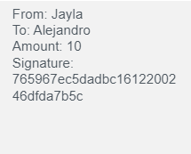
Blockchain Lesson 2 - Activity
1
3
2
0
74
Nonce
Hash
8ac819deffa821dad822a01b728f6131
Hash
6c23dbf386a9cc809d2bdbe5d8768705
Hash
fcb79e8babddbd27b6ee4c9d47f80325
Hash
bc1612200246dfda7b5c765967ec5dad
Hash
5293c9a819a03628d978c0e6aae71c82
Hash
b6f93bd6276ab77430833c18fc4cf9ab
Hash
825293c9a819a03628d978c0e6aae71c
Hash
00978c0e6aae71c825293c9a819a0362
Try to find:
00...
Proof Of Work

Slide 23
Key Vocabulary
Blockchain Lesson 2 - Activity
Nonce: A number used to try and change the hash of a block of messages so that it starts with a unique set of 0’s. It’s an abbreviation for “Number used once”.
Mining: When you continually generate new numbers to try and get a hash to start with a unique set of 0’s. This is a puzzle that can only be solved by guessing.

Slide 24
Blockchain Lesson 2 - Activity
💻
Do This
Complete Scenarios 3-5 on Code Studio, investigating each Blockchain scenario.
Record your answers on the activity guide

Slide 25
Prompt
Blockchain Lesson 2 - Activity
Look back at the scenarios in each of these levels. Since the transactions are public, we can see how these people are trading money.
Look through the scenarios and see if you can identify one that seems like it has a pattern. What story can you tell about that scenario amongst that group of friends?

Slide 27
Journal Prompt
Blockchain Lesson 2 - Wrap Up
The blockchain helps facilitate thousands of transactions each day between people who’ve never met or trust each other. Based on what you’ve seen today, how does cryptography help the Blockchain accomplish this goal?

